Slide 1
Bow-Tie Analysis

Slide 2
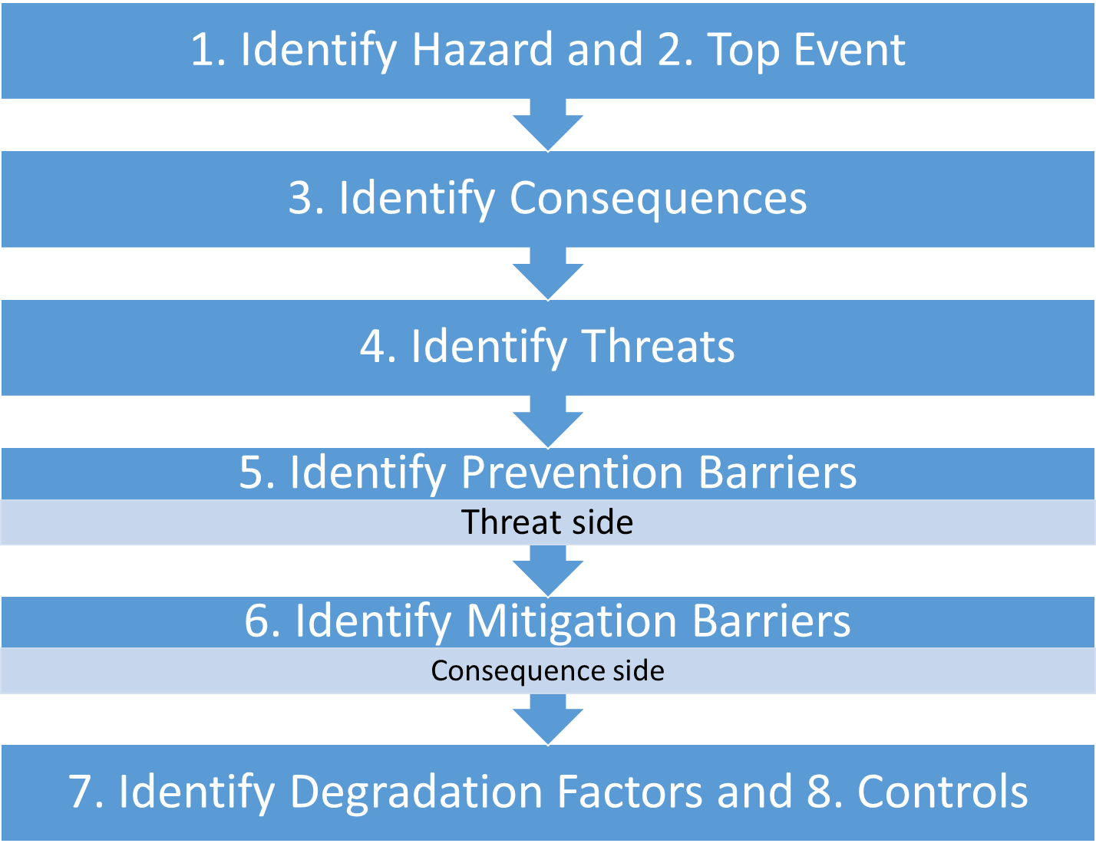
Notes:
Steps of Bow Tie

Slide 3
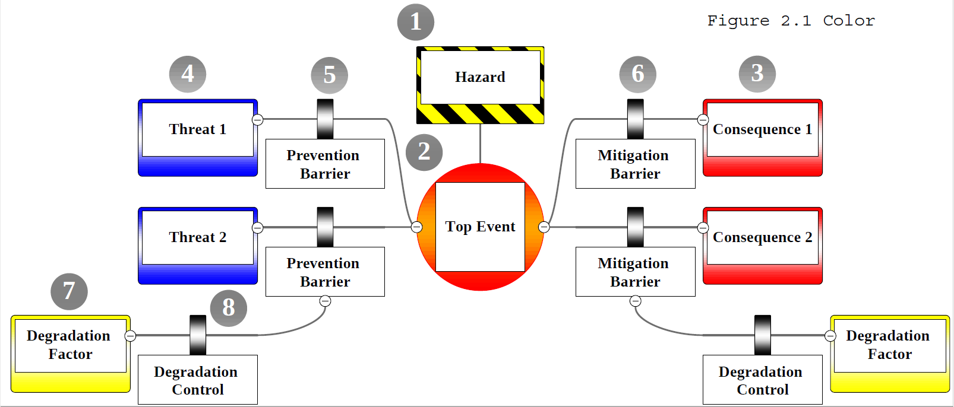

Slide 4
Bow-Tie Analysis
Images

Slide 5



__________ “due to” ____
Hazard
Threat
Consequence
TOP
EVENT
Prevention Barrier
Mitigation Barrier
Degradation Factor
Degradation Control

